Slide 1
Using the Internet?
Is the internet a safe place?

Slide 2
Starter –discussion:
I’ve just bought a computer:
What software MUST I install to keep my computer safe on the internet?

Slide 3
Learning Outcomes
Must be able to describe steps to keep themselves and the computer safe on the internet.
Should be able to discuss what internet banking is, what it does, how you log on and some of the dangers.

Slide 4
Some key terms: What is the difference?
1. Spam
2. Hacking
3. Phishing
4. Virus
5. Malware
Get online:
Find a meaning and share it with the class.
Become
5 mins go!!!
Notes:
Spam – a way of sending large amounts of electronic mail especially advertising indiscriminately (without worrying about who you are).
Hacking – Gaining access to an account or an electronic device without the persons permission.
Pharming – When you are redirected to a fake/bogus site that is identical to the original. This is done by a virus changing your internet settings.
Phishing – An email (posing as someone/a company) sent to get you to give away usernames, passwords (usual financial)
Spyware – a type of malicious software on your computer that records and collects personal info without their knowledge
Virus – a piece of unwanted software that can spread to other machines and perform functions
Malware – an umbrella term for any piece of software designed to disrupt your computer. (includes, spyware, virus, worms etc). Another term is malicious software.

Slide 5
Phishing
http://www.youtube.com/watch?v=wSoXBOOK65Q&safe=active

Slide 6
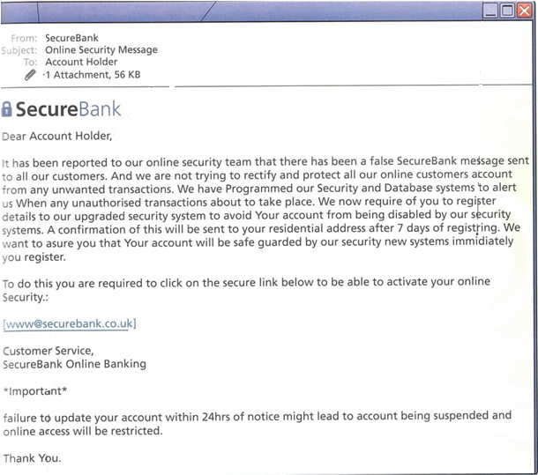
What is phishing?
Phishing
Here is an email:
There are 5 clues on here that indicate that it is a fraudulent phishing email...
In pairs...What are they?

Slide 7
Quick recap of key terms – what am I talking about? Match up my description with the keyword.
Spam
Hacking
Pharming
Phishing
Spyware
Virus
Malware
Notes:
Spam – a way of sending large amounts of electronic mail especially advertising indiscriminately (without worrying about who you are).
Hacking – Gaining access to an account or an electronic device without the persons permission.
Pharming – When you are redirected to a fake/bogus site that is identical to the original. This is done by a virus changing your internet settings.
Phishing – An email (posing as someone/a company) sent to get you to give away usernames, passwords (usual financial)
Spyware – a type of malicious software on your computer that records and collects personal info without their knowledge
Virus – a piece of unwanted software that can spread to other machines and perform functions
Malware – is any piece of software designed to disrupt your computer. (includes, spyware, virus, worms etc)

Slide 8
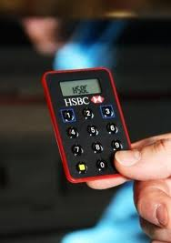
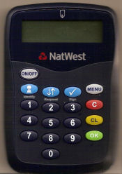
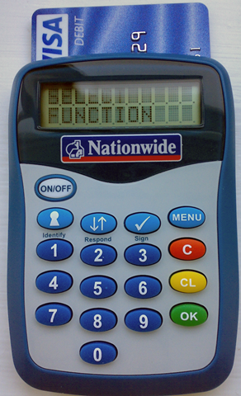
Internet banking safety

Slide 9
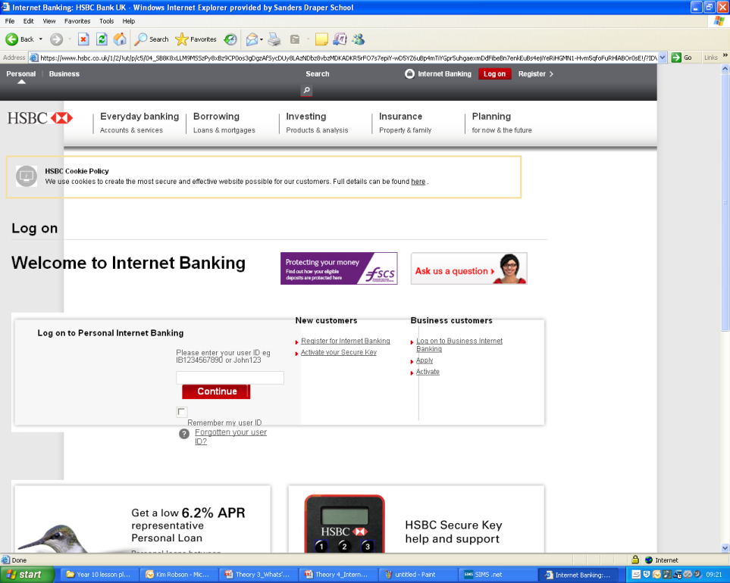
How to logon safely...1
All banks do it slightly differently...but this how HSBC do it...
Enter your unique ID number

Slide 10
How to logon safely...2
All banks do it slightly differently...but this how HSBC do it...
Enter a memorable restaurant name that you have chosen
Create a pass code using your pass code generator.
This produces a unique code every time you logon
Enter your passcode

Slide 11
How to logon safely...3 Question:
I have no idea what the unique passcode generator means.
I have no idea how the website recognises the code.
Why is it important – I don’t know?

Slide 12
How to logon safely...4
What I’ve spent money on
Pay a bill
Send money to another account
Look at your bills and money going out
All your transactions- and your balances

Slide 13
Why is internet banking so useful?
Discuss...write 3 reasons...

Slide 14
Internet Banking (6 mark question example)
Internet Banking is gaining popularity amongst people. Discuss why people should do it, some of the issues involved in internet banking and suggest ways that people could keep safe.
Basically – internet banking

Slide 15
Internet Banking (6 mark question example)
Internet Banking is gaining popularity amongst people. Discuss why people should do it, some of the issues involved in internet banking and suggest ways that people could keep safe.
FIRST OFF – Why are people turning to internet banking? (Advantages)
SECONDLY – What issues will there be? (Disadvantages)

Slide 16
Internet Banking (6 mark question example)
Internet Banking is gaining popularity amongst people. Discuss why people should do it, some of the issues involved in internet banking and suggest ways that people could keep safe.
Basic Framework
“People are using internet banking because...it allows them to...they can...”
“There are also issues with internet banking...”
“People can minimise the risk by...”

Slide 17
Peer assessment
What does a 5-6 mark answer look like?:
(For and against argument – justified (not just stated). Specialist terms used.)

Slide 18
Some key terms: What is the difference?
Spam
Hacking
Pharming
Phishing
Spyware
Virus
Malware
Are you happy with what they all are?

Slide 19
Plenary – over the past 4 lessons
Smart phones
Different Computers
Getting on the internet
Some internet issues
What issues that have been raised over the past 4 lessons – might you need to research more about.

