Slide 1
Phones!!!
What makes my phone smart?

Slide 2
Starter:
http://www.youtube.com/watch?v=utUPth77L_o

Slide 3
Starter – Paired activity Features of mobile phones
Memory Card;
GPS;
Radio;
Camcorder;
Voice recorder;
Predictive text;
Email;
MP3
Bluetooth;
Loud-speaker;
Touch-screen;
Video Calling;
Internet;
WiFi;
Personal Organiser;
Alarm
Are you happy with what all these mean?

Slide 4
Learning Outcomes
Must be able to Recognise the main features of smart phones;
Should be able to suggest features on phones to suit different needs.
Could be able to discuss some downsides to owning and using a smart phone.

Slide 5
Key Concepts
Smart phone – what is meant by this?

Slide 6
Key Concepts
Smart phone – a phone offering advanced features, e.g. the ability to send emails and surf the Internet.
Multifunctional – having the ability to do many different things using the same device.

Slide 7
The History of Mobile phones
http://www.youtube.com/watch?v=JcnXOhrmDB8

Slide 8
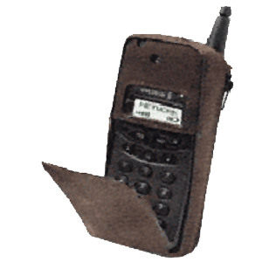
My first ever phone
It had a pully
uppy aerial!
It had a flippy bit!
I could make calls – I could store some numbers – (I cant remember if I could text tho)

Slide 9
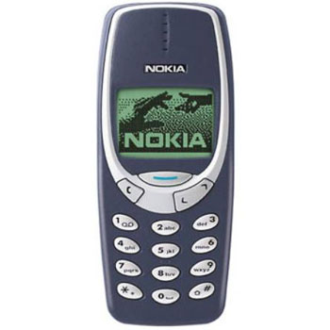
My favourite phone ever
I could send texts
It had a menu and I could choose
Ring tones and I used ALL the functions
(I think it may have also had ‘games’ but I cannot be sure!!?)
It had moving
graphic bits!
I also dropped it down toilets, left it in taxis, dropped it on dance floors, left it in the rain and dropped it down stairs – but still it kept on working.

Slide 10
Paired Activity
What do you look for in a mobile phone?
Picture resolution;
Camera resolution;
Storage capacity;
Memory card;
Music and video player;
Connectivity;
Network
Messaging
Social networking
Internet / web
What is important? Why did you choose your phone?

Slide 11
Ok – Who is the mobile geek?
Explain 2 functions of a memory card?
What are the differences between SD cards, SDHC cards and Micro SD cards?
What is the difference between Bluetooth and WiFi?
Some phones have a NFC chip – whats it for?
Give three uses that a phone has for having GPS built in.

Slide 12
Answers
Allows you to store extra information and a back up storage devise;
Secure Digital – secures up to 2 GB of data. Secure Digital High Capacity – ideal for video cameras as you have up to 32 GB;
Exchange of data over short distances, WiFi exchanges data over much larger distances;
Stands for Near Field Communication – which allows you to pay for things by just waving your phone.
Current location, directions from current location to specified location and distances.

Slide 13
Your phone...
List as a group everything your phone can do...

Slide 14
Your phone...
Now, How much of it do you actually use?
Circle what you actually use? How much of it is wasted?

Slide 15
Your phone...
So, why do they put it in the phone?

Slide 16
Car Phone Warehouse Research Activity – Role Play
Imagine you work for the Car Phone Warehouse and I come in and want to buy a new phone. What phone would you recommend and what questions would you need to ask me?
Remember, I don’t know what any of this stuff means!
I need the phone for work and leisure.

Slide 17
Phones for different needs
Think about the wide range of people who use mobile phones.
Children
Old people
Technophobes
Disabled people
Hard of hearing
Partially sighted
What features are available to cater for all these people?
Notes:
Size of the screen
Weight of the phone
Size of buttons
Panic button?
User friendly interface
Screen resolution
Navigation system around the menus
Voice recognition
Vibrate feature
Volume control
Change of language
Different ringtones for different people
Keyboard rather than touch screen

Slide 18
Plenary...QUICK possible exam questions... Answer the following questions – in silence
Give 2 purposes of a memory card...(2 marks)
Explain the difference between bluetooth and wi-fi? (2 marks)
Some people (old people) find it difficult to use mobile phones. Suggest features that can make a phone easier to use. (4 marks)

Slide 19
Extension task - brainstorm
What are the downsides to using Smart Phones?
Half a page:
Financial
Practical
Personal Safety
Notes:
Battery life
Expense of buying and contract
Easily broken
Complicated

Slide 20
Plenary...Our lesson outcomes
Recap on lesson outcomes
Answers to the questions?

