Slide 1
Online communities 1
Theory revision
Complete some of the activities in this powerpoint and use the revision book to answer questions.

Slide 2
Open up...do the starter task

Slide 3
Starter - Online communities – what are they?
Social Networking
Online community where people are linked together using personal information
Online work spaces
A online place where people can work together in collaboration
ni
Blogs
An online journal
Virtual worlds
Computer based simulation environment – using avatars to represent themselves
Microblogs
Web communication using short text messages (twitter for example)
User generated sites
Sites where the content is created solely by users

Slide 4
Lesson outcomes
All will be able to identify types of online communities and the differences
Most will be able to describe the positives & negatives of Social Networking
Most will be able describe different user generated sites and identify pros and cons.
Some will be able to discuss how the internet changes the way knowledge is created.

Slide 5
Progress check... Answer question (b) on page 56. 2 marks – 2 minutes

Slide 6
Social Networks – quick class question...
How would you define a social network?
What makes it different from say: a message board or site about; e.g ‘One direction’
Answer:

Slide 7
Social Networks – good and bad:
Definition:- An online community where people are linked together using their personal information
In an exam you might have a question about something to do with Social networks and benefits and downsides.
Advantages - what are the good features? | Disadvantages – what problems are there?
One message to reach lots Allows real time chat Can send messages on the internet rather than SMS or phone signal Can add metadata such as date time location of photo taken Can upload and share multimedia | Loss of privacy People impersonating others Privacy settings change Lots of people can see images + details of your life
Notes:
Suggestions:
One message to reach lots
Allows real time chat
Can send messages on the internet rather than SMS or phone signal
Can add metadata such as date time location of photo taken
Can upload and share multimedia
Loss of privacy
People impersonating others
Privacy settings change
Lots of people can see images + details of your life

Slide 8
Progress check Answer question (a) page 56 Answer question (a) page 58 4 marks – 4 minutes

Slide 9
User Generated reference sites What does this phrase mean?
A website that allows people to leave messages?
A website that only allows people to read the content?
A website that allows people to add and edit the content on the site?
A website that allows people to link to pages in it?
A website that allows people to download images?
Notes:
Content on the internet that is created by USERS
Allows users to contribute and share information

Slide 10
Quick 2 minute task:
Think of the most obscure topic, hobby or interest you can:
Is there an online wiki, site, blog, message board dedicated to that topic, hobby or interest...
Go and find out – you have 2 minutes...

Slide 11
User generated reference sites – 1. match up the keyword to the meaning 2. Decide which of the statements are advantages or disadvantages
Forum / message board
Allow people to hold discussions by posting messages about a topic. The message is usually moderated for unacceptable content or may not be updated instantly.
Newsgroups
Are communities that allow users to discuss a particular updates on a topic
Wikis
A site where users can add or edit content collaboratively.
Review sites
Allows users to post reviews to inform potential customers of the product/ service they are considering buying
Chat sites
An online conference – usually in real time
Wikis can easily be changed by users so the information on the websites can be up to date
An internet connection is needed for people to work collaboratively
People from different parts of the world can work together to create content
The information may become disorganised and include errors and duplicaiton
They often do not require users to pay a fee and contain a huge amount of information.
As anyone can contribute information, it can become inaccurate, baised or untrue if not carefully managed
Notes:
Match them up at the top and put

Slide 12
Progress check Answer the questions on page 59 6 marks – 6 minutes...

Slide 13
Social Bookmarking sites
They are different from user generated reference sites.
People add bookmarks (weblinks) rather than contribute information
“Digg.com” is a social news website where people can share stories and rate them.
They are places in which people collect internet stuff.

Slide 14
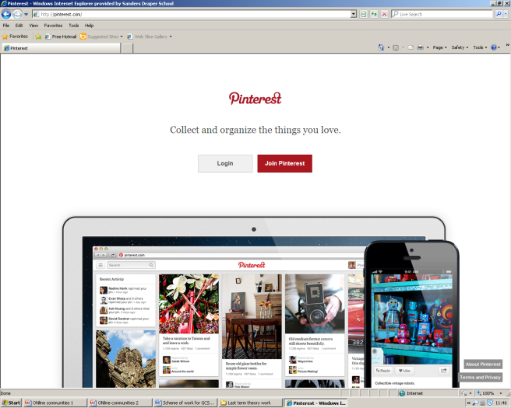
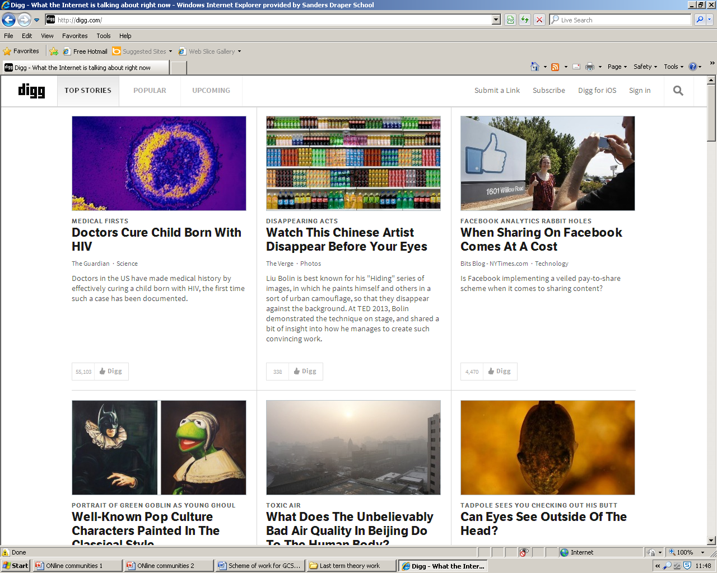
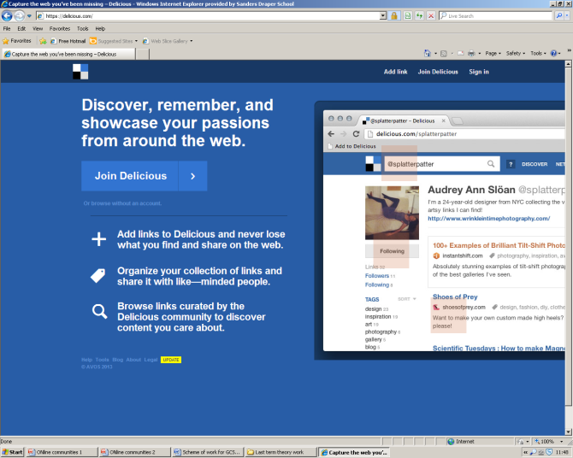

Slide 15
Social Bookmarking sites
People can store web links online
Things are ‘tagged’
Tags can be used to search bookmarks by their topic and category
People can share bookmarks
People can like / dislike or rate content
The internet is a fast moving place and can be out of date
People can copy the material and pass it off as their own, just because someone else thinks its important does not mean it is.

Slide 16
Creation of knowledge – 10 minute task
Discuss the impact of the internet on the way knowledge is created.
Before answering this 6 mark question...break it down....
Some simple starter questions:
Who can create knowledge?
How is it shared?
With whom is it shared?
The quality and accuracy of the information?

Slide 17
Creation of knowledge – page 61
ICT and online communities have changed the way knowledge is created.
6 mark question in book
Positives | Negatives

Slide 18
Creation of knowledge
Discuss the impact of the internet on the way knowledge is created.
Positives | Negatives
Published immediately over the world Constantly updated | It is overwelming – there is a lot of information
Everyone and anyone can publish Content shared automatically | No one checks for bias or inaccuracy? How do we know that it is true? How do we know its just not misleading?
Readers and users can decide which is important | People without technology cannot access the information - the digital divide
Information can be made accessible all over the world by anyone (universities)

Slide 19
Creation of knowledge - framework
Discuss the impact of the internet on the way knowledge is created.
E.g “The internet has meant that millions/billions of people have access to news and up to date information however this has lead to those people without an internet connection to miss out on information spread on the web”
“The internet has revolutionised the way that knowledge is created...”
“The internet has meant that....HOWEVER (connective)...this has lead to...”
3 x positives ? 3 x negatives?

Slide 20
How did we do in our revision lesson...
All will be able to identify types of online communities and the differences
Most will be able to describe the positives & negatives of Social Networking
Most will be able describe different user generated sites and identify pros and cons.
Some will be able to discuss how the internet changes the way knowledge is created.

