Slide 1
Computer bits and pieces
Hardware! Do you actually know anything about the devices you use?

Slide 2
Starter – order in size smallest to biggest
Bit
Nibleb
Byte
Kilobyte
Petabyte
Megabyte
Terabyte
Gigabyte

Slide 3
Lesson outcomes
All of you will be able to identify the main components and their role in a system
Most of you will be able to explain and identify the best computer for a given situation
Most of you will be able to analyse, suggest and compare different hardware

Slide 4
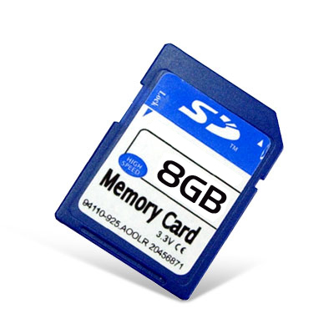
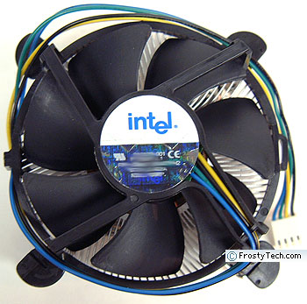
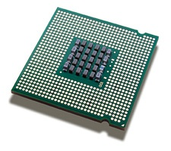
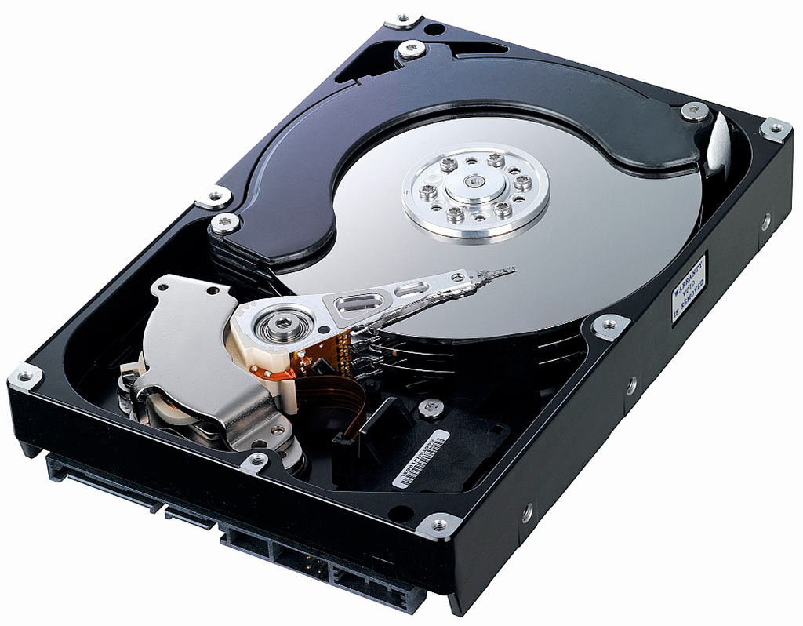
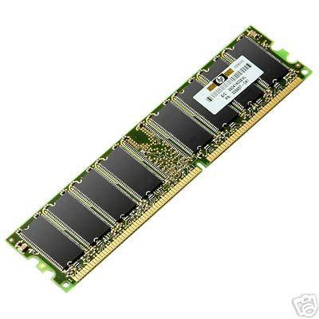
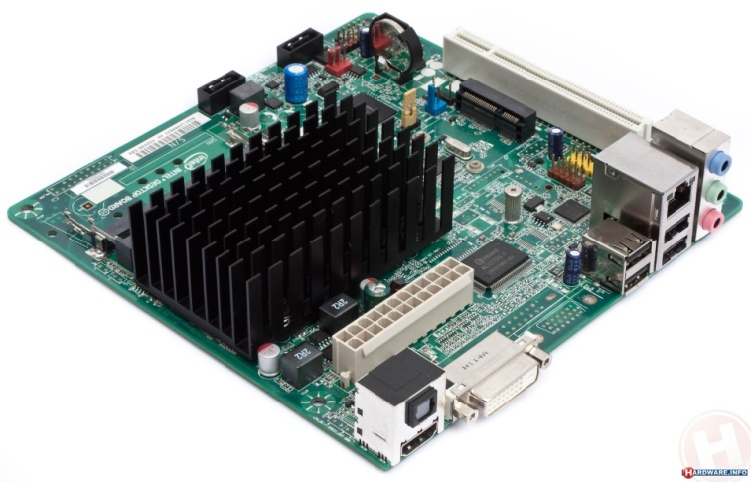
What are these little bits? Think, pair share...

Slide 5
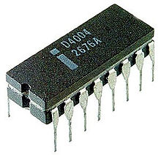
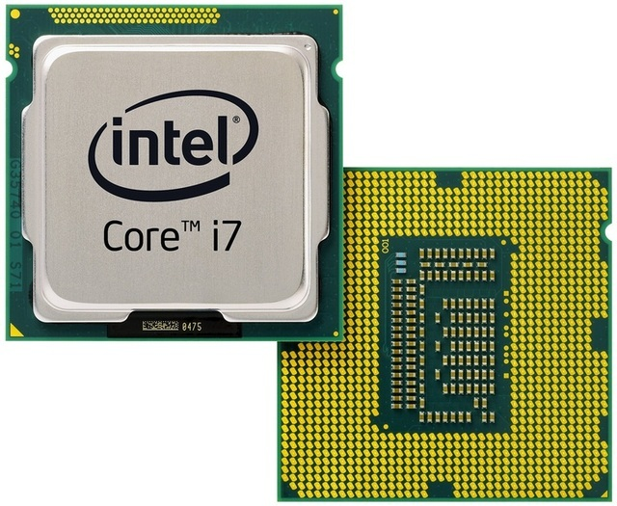
CPU / Processor / Microprocessor
The first microprocessor
One of the latest microprocessors
Notes:
Show the processors around.

Slide 6
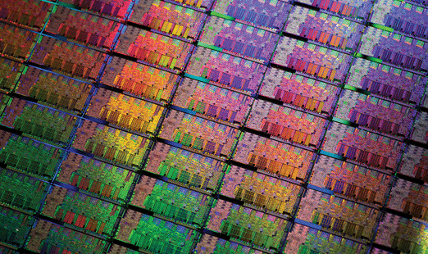
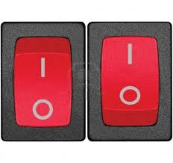
Key concept...
Processors are made up of thousands of transistors.
Transistors are used to switch electronic signals around a circuit.
So, the equivalent would be...
They are microscopic.
Notes:
http://newsroom.intel.com/docs/DOC-2476
Or the how do you make it?

Slide 7
CPU / Processor / Microprocessor
Microprocessors are measured by a ‘clock speed’
Its like a metronome ticking...sending out a regular pulse.
It then makes the calculations and processes the data synced up to the pulse.
The number of calculations it can do in one second is measured in Hertz.
1 calculation
a second =
1 Hz
2,000,000,000 calculations
a second =
2 GHz
Notes:
The school computers are 2.13 GHz
Iphone 1.6 I think

Slide 8
Quick Quiz – think pair share
What is the main component of a processor?
Why is it referred to as the brain of the machine?
What is its speed measured in?
What is the processor composed of?
Notes:
Higher order questioning...
Where does it come from? Name the place where it originated?
What type of things does it do?
Why is it measured like that?
What do they do?

Slide 9
RAM – think, pair share...
When the computer is active it needs memory to store data and instructions temporarily.
How do you make use of the RAM
When writing an essay or getting images from the internet?
Notes:
Copy and paste

Slide 10
Oh oh...When its gone, its gone...
Thinking time...
My computers just switched off...My work wasstored in the RAM
Discuss
What are the consequences?
What are the preventions you could put in place?
Notes:
What are the consequences?

Slide 11
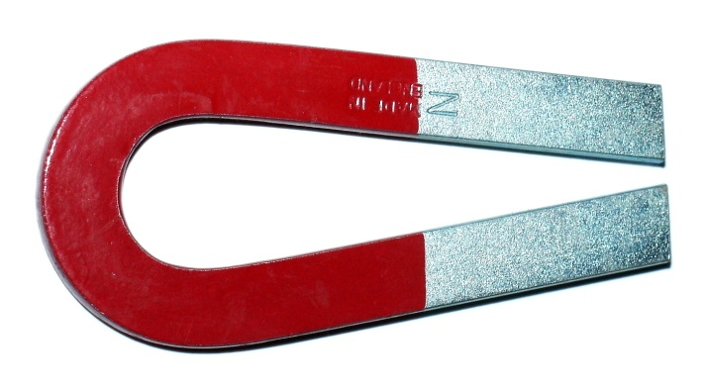
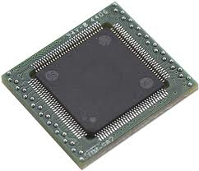
Secondary storage
Optical
Magnetic
Solid State
Uses a laser...
Uses a magnet
Stores on a chip

Slide 12
Optical?
Magnetic?
Solid State?
or
or

Slide 13
Optical?
Magnetic?
Solid State?
or
or

Slide 14
Optical?
Magnetic?
Solid State?
or
or

Slide 15
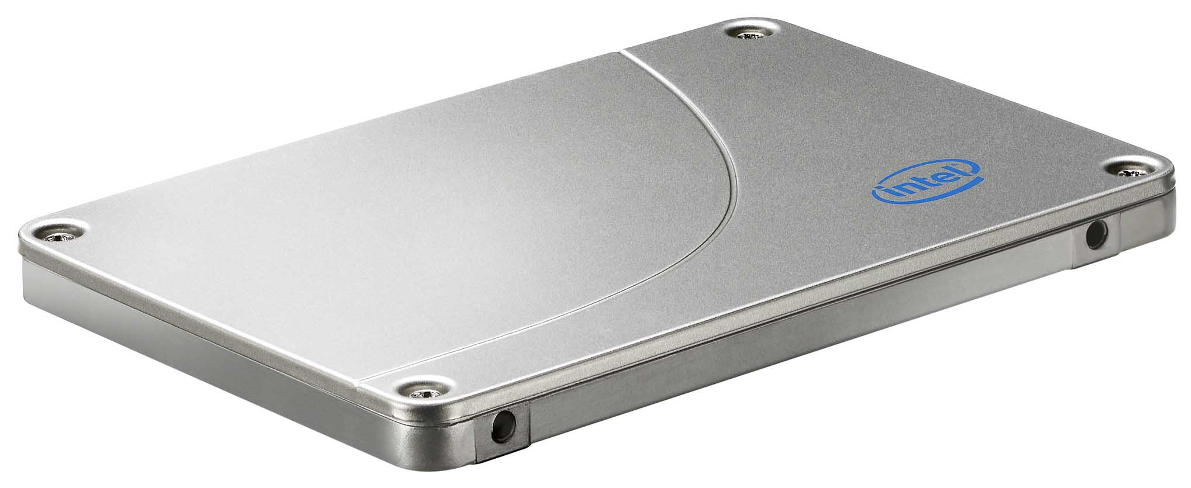
Optical?
Magnetic?
Solid State?
or
or

Slide 16
Optical?
Magnetic?
Solid State?
or
or

Slide 17
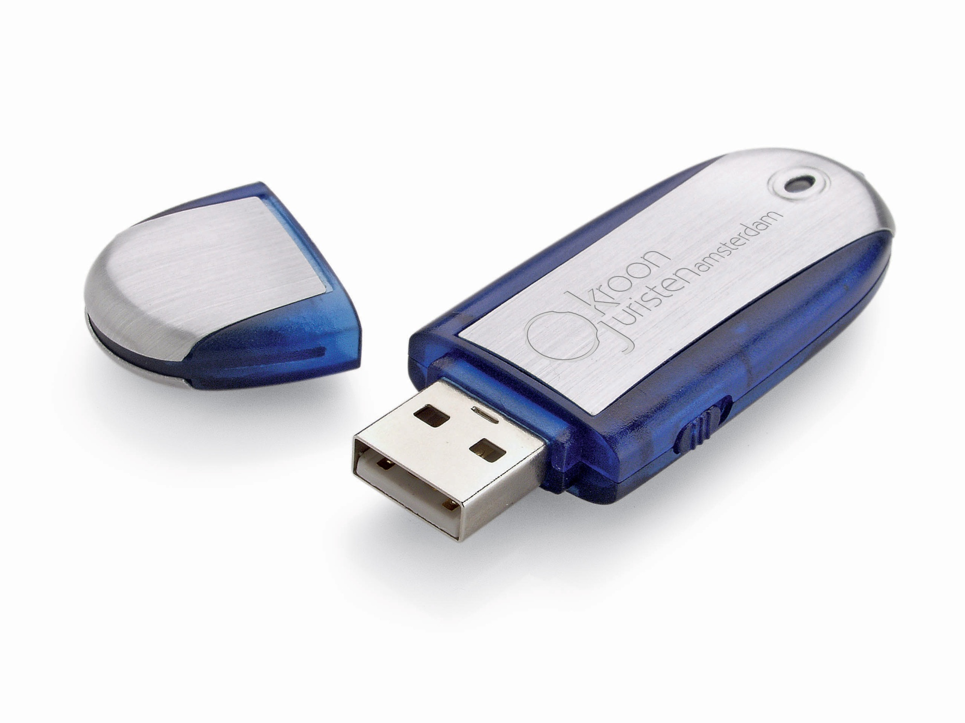
Optical?
Magnetic?
Solid State?
or
or

Slide 18
Motherboard – where its all kept

Slide 19
What is the best choice?
 | Laptop 1 | Laptop 2 | Laptop 3 | Laptop 4
Display | 12 inch | 15 inch widescreen | 17 inch widescreen | 20 inch widescreen
Processor | 1.6 GHz | 1.8 Hz | 2 GHz | 2.8 GHz
Memory | 1 GB | 3 GB | 4 GB | 8 GB
Hard Drive | 160 GB | 250 GB | 2 TB | 1 TB
Wireless enabled? | Yes | No | Yes | Yes
USB Ports | 2 | 4 | 4 | 8
Card Reader | Yes | No | No | No
Webcam | No | Yes | No | No
HDMI | No | No | Yes | No
Notes:
Which would be the best choice for a laptop for biometric identification?
Which can I plug into my HD telly?
Some of the information for laptop 2 is clearly incorrect? Which one?
Which has got the most RAM?
Which one has the most storage space?
Which one is best to use with my digital camera?
Which one could I use for travelling?

Slide 20
Questions:
What component is the brain of the computer?
What memory is used while the computer is active?
What type of storage is a blu ray disk?
Where are all the components located in a computer?
Where is something you copy and paste stored?

