Slide 1
Online communities 2

Slide 2
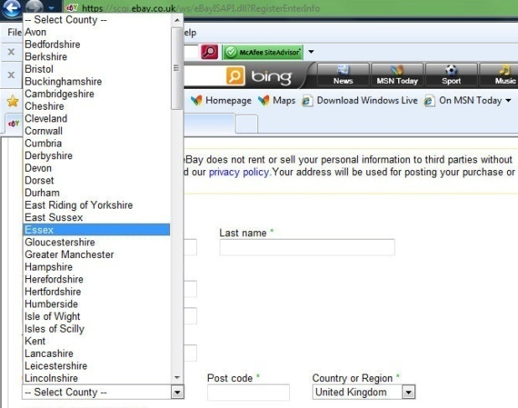
Starter: Signing up to an online account:
When signing up to a new account you sometimes have to fill in one of these:
This is called a:
A Watcha test B Gotcha test C Captcha test
D Motcha test
When signing up for an account:
There are times when you have to enter details into the box before you can proceed these are known as:
Validation
Name checking
Data Entry
Required fields
Firewall
Verification
When you buy things on the internet, you have to set up an account with a username and password.
When you enter details – you often have to select using a drop down or combo box. This ensures that what you enters actually exists and can be used. This form of checking data entered is called:
Validation
Name checking
Data Entry
Verification

Slide 3
Lesson outcomes
All will understand and be able to explain the meaning of ‘online workspaces’ and ‘VLEs’.
Most will be able to discuss the impact on working life practices.
Most will be able to list ways of socialising and Set up some rules for responsible internet use.
Some may be able to discuss the impact of ICT on a global scale...

Slide 4
Definition: question?
What is the really OBVIOUS difference between these two online communities?
VLE – Virtual Learning Environment
Online Workspace

Slide 5
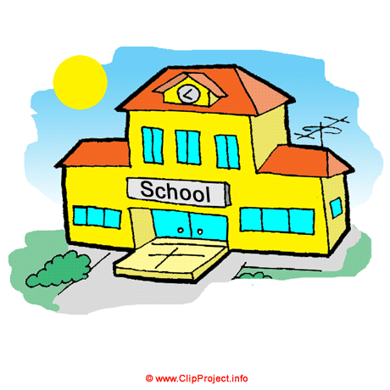
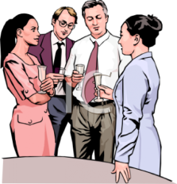
Sorting out task... Which are aspects of a VLE which are a workspace?
School
Workplace
Ability to contribute to message boards and personalise their own space
Different levels of access to different employees to documents for security purposes
Can do homework at home or at school
Shared folders so people can work on the same document
Interactive polls and questionnaires
Web chat or VOIP (Voice over the internet protocol – or Skype)
Can be used to give additional resources
Online conferencing
Marking tools
Email chat and communication
Attendance and punctuality can be tracked
Can allow people to work from home and from all over the country or the world at different times
Timetable news for staff and students
Students, parents and students can track progress and data such as test marks

Slide 6
Progress check... Answer questions on page 57. 4 marks – 4 minutes

Slide 7
The impact of ICT on working life... All answers to come from students...
Give advantages of working from home to employees | Time = Money =
Give an advantage to an employer of people (potential employees) using social networks
What service may help people access their files from anywhere? (as long as they have internet access – think apple)
Give a disadvantage of email within a company
What is a disadvantage of being heavily reliant on the internet?
Give a disadvantage to an employee to people using social networks
Give a disadvantage to employees always being contactable at home?

Slide 8
Progress check... Answer questions on page 62. 10 marks – 10 minutes

Slide 9
Socialising:
You have one minute – list as many ways people socialise as possible on the internet
Notes:
Skype (VOIP)
Social Networking
Chat rooms
Online games
Virtual worlds
Blogs + microblogs
Message boards / forums
Social Bookmarking
Friends reunited
Online dating
Etc etc

Slide 10
Quick question:
When you sign up for an online account:
You agree to the rules given in an acceptable use policy or code of conduct.
What happens if you break the rules?

Slide 11
We are going to set up a message board about Justin Beiber... (I’ve chosen him for a reason)
Lets come up with some rules for joining our forum...(Acceptable use policy)
1
2
3
4
5
Notes:
I will keep my user name and password safe
I wont use someone elses
I wont use offensive language
I wont take or distribute images without their permission
...not use anyones details
Etc etc

Slide 12
The impact of using ICT on a global scale...
Lets start off with
3 positive
3 negative
Of ICT on a global scale.
Positives: Answer these questions>
How has it changed communication
The number of ways to communicate

Slide 13
The impact of using ICT on a global scale...mini framework
Lets start off with
3 positive
3 negative
Of ICT on a global scale.
Positives: Answer these questions>
How has it changed communication?
The number of ways to communicate?
How has it affected our buying habits?
How has it affected how businesses grow around the world?
Negatives: Answer these questions>
How does the internet change other cultures and individualism?
How do governments (e,g China, Iran) respond to the internet?
What effect does it have on countries with poor ICT?
How has global trade affected labour in other countries?
however

Slide 14
The impact of using ICT on a global scale...mini framework
positive
“The rise of ICT in particular the internet has meant that people have access to an enormous amount of information and can keep up to date with news in real time – this has benefited some groups looking to change the politics in a particular country. This however has lead to some countries trying to control the internet blocking sites like Facebook in which they feel they have little control over.”
Connective
Negative

Slide 15
Progress check... Answer questions on page 64. 6 marks – 6 minutes

