Slide 1
Year 11 Revision
1 hour left...

Slide 2
Quick Question 1:
Which pinpoints your location:
SMS
Or
GPS

Slide 3
Quick Question 2:
CDs and DVDs Are types of:
Optical Media
Or
Solid state memory

Slide 4
Quick Question 3:
An online learning environment:
VLE
Or
CPU

Slide 5
Quick Question 4:
Which is bigger:
Tb Or Gb Or Mb

Slide 6
Quick Question 5:
A method of sending audio over the internet
VOIP
Or
ISP

Slide 7
Quick Question 6:
Watching something like iplayer or youtube
Streaming
Or
Downloading

Slide 8
Quick Question 7:
Accessing someones computer without permission
Data Protection Act
Or
Computer Misuse Act

Slide 9
Quick Question 8:
When ideas are spread by sharing links via social media
Viral Marketing
Or
Social bookmarking

Slide 10
Quick Question 9:
When you “save” files on your computer; its on the...
RAM
Or
Hard Disk

Slide 11
Quick Question 10:
When you press a button and you have to wait for the computer to catch up is the...
Latency
Or
Buffering

Slide 12
11. Which has biggest capacity?

Slide 13
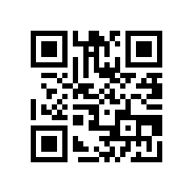
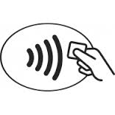
12. Which will allow you to pay?
Give the term

Slide 14
13. Which will scan with your camera?
Give the term

Slide 15
14. Which processor would be fastest?
700 Mhz
7 Ghz

Slide 16
15. Which is (a) biggest – which is (b)smallest
Gb
Mb
Tb
Kb

Slide 17
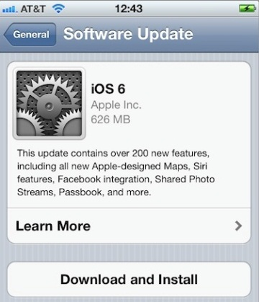
16. Update in progress
Why do
companies
send updates
to devices?

Slide 18
Speaking and listening
Which keyword am I talking about?
Spam
Megabytes
GPS
PIN
Peripherals
malware
Laptop
Voice recognition
NFC
RAM
Spec
Phishing
Optical Drive
SD Card
Processor
MP3
Netbook
CPU
Notes:
A type of disk drive that uses a laser (DVD, CD, Blu Ray)
The brain of the computer – the component that makes all the calculations
A type of misleading email that tries to get passwords and personal information from you
A type of portable computer that is charactierised by small size, price, low processing power, good battery length
A way for people to be able to control their phone using speech
The devices that are linked to the computer - on the outside of the machine
A way of finding your location on your phone
The list of all that is in your machine, all the features, performance and connectivity
A type of digital music file
A way of paying for things on your phone by just swiping the phone over a reader

Slide 19
Some key terms: What are the odd ones out?
A
B
D
C
RAM
CPU
Optical Drive
Hard disk
Malware
Thunderbolt
Specification
Peripherals
Spam
Hacking
Malware
NFC
Phishing
Virus
Attachment
GPS
NFC
Siri
Touch screen
Bluetooth
Gigabyte
Predictive text
Laptop
PDA
Tablet
Smart phone
Software
Games console
Desktop PC
Netbook

Slide 20
Which of these would be ADVANTAGES to shopping online
B.
A.
Can order at any time of day or night
Can compare items
E.
Can not actually touch/feel item
D.
Receive order confirmation immediately
Item may not look as picture
C.
Can read customer reviews
F.
May not be home to receive the item
G.
May have to pay for postage
H.

Slide 21
Puters!
Name | Screen Resolution | Storage | RAM | CPU | Optical Drive
Dell | 1020x720 | 500GB | 1GB | 2GHz | DVD
Acer | 640x420 | 250GB | 2GB | 1.5GHz | CD
HP | 1020x1080 | 1TB | 4GB | 1.9GHz | Bluray
Apple | 2150x1900 | 550GB | 8GB | 1.8GHz | DVD
Notes:
Possible Exam Questions
18. Which Laptop has the best screen resolution ?
19. Which Laptop can hold the most data?
20. Which Laptop has the least RAM?
21. Which Laptop can you play HD movies on?

Slide 22
22 (a) and (b) Phones
Name 2 security features that phones have.

Slide 23
23. Data, data, data!
Which of these could be deemed as
Sensitive Personal Data?
Religion
Dogs name
Political opinions
Shoe size
Racial / ethnic origin
Criminal record
Collar size
Height
Football team
Type of car you drive

Slide 24
24 (a) and (b) Quick!
Give two indicators of a secure site...
What should we look for on a secure site?

Slide 25
25. Doing it online...
a. Advantage of buying cinema tickets online | b. Advantage of buying groceries online

Slide 26
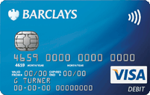
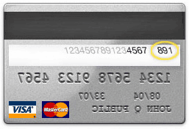
26 and 27 Dosh...paying safe online
B
F
A
C
G
D
3 digit security number
H
E
Notes:
Which of these is the Credit Card Verification code or CCV?
What’s it for?

Slide 27
28. On sentence only:
Explain the Digital Divide in one sentence?

Slide 28
29. Explain the keyword
Accelerometer
NFC
GPS
WiFi
Bluetooth
Portable hotspot
Flight mode
QR Code
Notes:
i. When you create a connection to the internet using your phone
ii. The little device that senses any movement in your device
iii. When you turn off any means of recieving or sending data from your phone

Slide 29
David & Susan take their personal digital devices with them when they travel abroad.
Discuss what they need to consider when they want to use their devices away from home. (6 marks)
http://www.online-stopwatch.com/talking-clock/

Slide 30
How many of these did you include?

Slide 31
Anyone in the developed world can publish anything anytime and the instant it is published, it is globally available and readily findable (Shirkey, 2008:71)
Discuss the impact on the use of news and information services
http://www.online-stopwatch.com/talking-clock/

Slide 32
How many of these did you include?

Slide 33
Topics you might need to revise
Digital Divide
Convergence of technology
Ewaste
Ecommerce
Web Optimisation
Open source software
Challenge Response
Viral Marketing
Social Bookmarking

Slide 34
The 6 mark questions...
What could they ask you?
I have a hunch:
- Ewaste and issues surrounding this
Biometrics and data protection
Online piracy / copyright
Social bookmarking / viral marketing
I think they may ask about smart TVs as well...

Slide 35
http://sitdownandlogon.weebly.com/

