Slide 1
Work through these...
KEY WORDS!!!
An excellent way to revise

Slide 2
Acronym – match ‘em up
Universal Serial Bus
Voip
SMS
PIN
SSID
URL
LED
VLE
GPS
ISP
CCV
HTTP
USB
HDMI
Hyper text transfer protocol
Credit Card Verification
Standard message service
Light Emitting diode
Voice over the internet protocol
Internet Service Provider
Service Set Identification
Universal Resource Locator
Personal Identification Number
High Definition Media Interchange
Virtual Learning Environment
Global Positioning System

Slide 3
Acronym – what are they?
Voip
SMS
SSID
URL
LED
VLE
GPS
ISP
CCV
HTTP
USB
HDMI
A text message
An example is...SKYPE!
The name of your wi-fi network
The number on the back of the card
A website address!
A type of really thin telly!
A cable needed for Hi def TV
A place you can log into and work online – (mymaths)
A way of locating you using satellite tracking
The company that provides you with the internet
A connector that can be used for peripheral devices
A protocol of the internet (the start of a web address)

Slide 4
Legislation – which belongs where?
Data Protection Act | Computer Misuse Act | Copyright and Patents Act
Hacking into a computer to access data
Personal data should be kept secure
Downloading music from the internet without paying for it
You should collect data in a fair and lawful way
Personal data should be relevant for the purpose its used for
Personal data should not be kept longer than necessary
Copying text from web pages and passing it off as your own work
Creating a virus to cause harm to someone’s computer
Taking images off the internet and using them to sell in products
No one can sell your details and data to anyone else
Personal data should be accurate and up to date

Slide 5
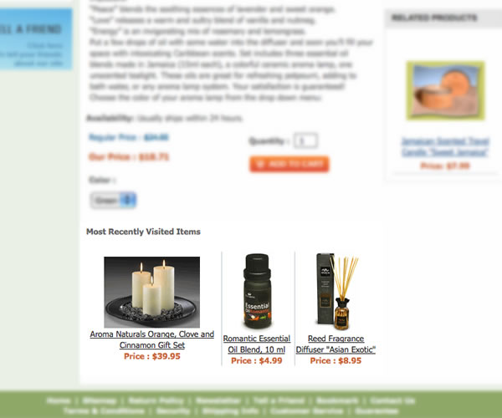
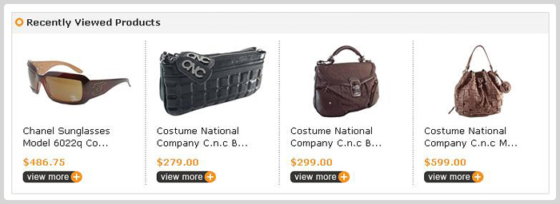
Fill in the blanks:
Each time you buy something online, ____________________ is created. This can include date/time, price, seller, product ID etc. This can be used to send you ________________ advertising and they don’t send you promotions for goods irrelevant to you. When you visit a website to buy something; what you search for, what you’ve bought, what you have looked at is stored in a ____________. This allows the website to create a ___________________ experience for you when you visit again.
Choose from:
Cookie – Ecommerce – data – targeted – viral marketing – adverts – personalised – most visited – transactional data – basket – email -

Slide 6
Multimedia and other little bits
Making sure what you type in is in the correct format
Putting files on a disk
Upload
Download
Stream
Buffer
Burn
Rip
Putting stuff onto the net
The time taken to wait for the material to load so we can watch it
Making sure you are who you say you are
Watching it live from the net
Taking stuff off a disk and turning it into a file
Taking stuff off the net
Validation
Verification

Slide 7
formats
.mp3
.avi
.mp4
.mpeg
.doc
.jpeg
DVD
Blu Ray
A storage disk (4.7+ gigabytes)
A Common compressed image file
Compressed video file
Common compressed video file
A WORD document
High capacity storage disk (25+ gigabyte)
Common compressed music file
Common video file (mostly good quality)

Slide 8
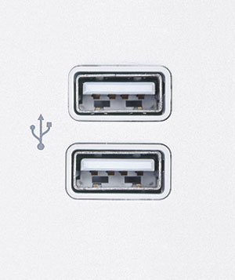
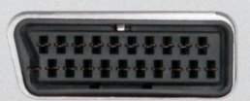
Lets connect 1. Label the panel 2. Suggest what device might be connected
Peripheral device such
as printer
VGA
HDMI
Hi Def video
TV
Computer monitor
Optical
Network
SD Card
Memory cards
5.1 stereo sound out
USB
Connect to internet
Scart
Audio in
Audio out
Micrphone
Speakers/headphones

Slide 9
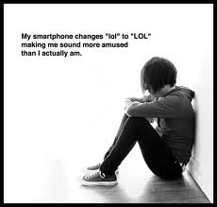
Phones...What? Uh?...Err?
Accelerometer
NFC
GPS
WiFi
Bluetooth
Portable hotspot
Flight mode
QR Code
A way of sharing your internet connection with your mates
A way of locating your position
A square barcode sort of thing that contains info like a webpage
A wireless way to transfer over short distances
A connection to the internet using a router not 3G or 4G
Turns off all wireless activity
Its a little sensor that detects movement...
A chip that can be used to pay for stuff

Slide 10
Getting online – draw them up with a line
WPA2
SSID
Mbs
WIFI
4G
Encryption
HTTPS
IMAP or POP3
IP Address
VOIP
3G
ISP
The password used on a wireless network
The speed of your internet
The name of you wi-fi (e.g bobsnet)
The people who give provide internet
Faster than 3G
Jumbling / scrambling data so it cant be seen
A connection to the internet
Tells you if it is a secure website
Using the internet to talk to someone (skype)
A numerical locator / address on a network
Not as fast as 4G
Lets you retrieve your email

Slide 11
Key term
The difference between those that have access to technology and those that don’t
Digital Divide
Convergence of technology
Ewaste
Ecommerce
Web Optimisation
Open source software
Challenge Response
Viral Marketing
Social Bookmarking
Techniques to make sure that your website is popular on search engines
Buying and selling on the net
Storing or sharing weblinks that may be of interest to yourself or others e.g Digg.com
A security question that you must give a valid response to
An advert that is spread by people sharing links on sites and social media
Electronic waste such as old phones etc
Software that is free to download and use

