Slide 2
Lesson objectives
3.1.2 Understand how computers represent and manipulate numbers [unsigned integers, signed integers (sign and magnitude, Two’s complement) real numbers]
3.1.5 Understand why hexadecimal notation is used and be able to convert between hexadecimal and binary and vice versa
All students will be able to convert between hexadecimal / binary / denary
All students will understand the term signed and unsigned integers
Most students will be able to explain sign and magnitude
Most students will be able to use Two’s compliment to represent positive and negative numbers.

Slide 3
Hexadecimal
Computers use the binary system to operate. However, it is possible to make mistakes using long lists of binary numbers...
Dec | 0 | 1 | 2 | 3 | 4 | 5 | 6 | 7 | 8 | 9 | 10 | 11 | 12 | 13 | 14 | 15
Hex | 0 | 1 | 2 | 3 | 4 | 5 | 6 | 7 | 8 | 9 | A | B | C | D | E | F

Slide 4
1. Base 10 to Base 16
Basic method
Example:
60 in binary is 111100
Turn to Hexadecimal:
60 / 16 = 3
Remainder = 12
12 = C
So: 60 = 3C
Put these into Base 16:
a) 76
b) 160
c) 65
d) 120
Make sure you add the working out...
Notes:
76 = 4C
160 = 60
65 = 41
120 = 78

Slide 5
2. Base 16 to Base 10
Basic method
Example:
7D in binary is 1111101
Turn to decimal:
7 * 16 = 112
D = 13
So: 7D = 112 + 13
7D = 125
Put these into Base 10:
a) 2F
b) 6C
c) 1E
d) 3A
Make sure you add the working out...
Notes:
2F = 47
6C = 108
1E = 30
3A = 58

Slide 6
3. Base 2 to Base 16
Basic method 1
Example:
Turn base 2 to base 10 then to base 16
Basic method 2
Example:
Split it in half
or
0 | 0 | 1 | 1 | 1 | 0 | 1 | 1
0 | 0 | 1 | 1
1 | 0 | 1 | 1
Convert
a) 00101010
b) 01001100
c) 10000001
What is this?
(48) = 3
What is this?
(11) = B
=3B
Notes:
2A
4C
81

Slide 7
4. Base 16 to Base 2
Basic method 1
Example:
Turn base 16 to base 10 then to base 2
Basic method 2
Example:
2F
Split it in half
or
What is 2 in binary?
(32)
What is F in binary?
(15)
Convert
a) 4F
b) 2A
c) 3C
0 | 0 | 1 | 0
1 | 1 | 1 | 1
0 | 0 | 1 | 0 | 1 | 1 | 1 | 1
Notes:
4F = 1001111
2A = 0101010
3C = 0111100

Slide 8
Happy or sad?

Slide 9
All the binary numbers that we have used so far have been positive numbers.

Slide 10
Keyword check
Signed or unsigned
A signed integer – a number that could be positive or negative
An unsigned integer – a number that is 0 or positive

Slide 11
Keyword check 1 – easy way to remember
Signed | Unsigned
+sign or -sign | Doesn’t need a sign!

Slide 12
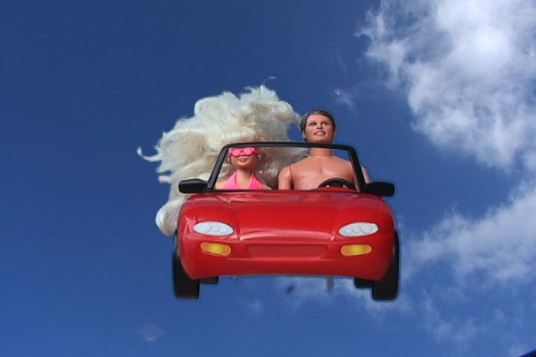
Let’s take a trip
To la la land

Slide 13
So what about:
Negative numbers?

Slide 14
Sign and Magnitude
10001101
00000111
The most significant bit.
1 = negative
What does this represent?
The most significant bit.
0 = positive
What does this represent?
Notes:
1 = negative, 0 = positive

Slide 15
Sign and Magnitude
Some issues with sign and magnitude
Both 1000 0000 and 0000 0000 represent 0.
It wastes one binary code.
10001101
00000111
The most significant bit.
1 = negative
What does this represent?
The most significant bit.
0 = positive
What does this represent?
Notes:
1 = negative, 0 = positive

Slide 16
Method 1

Slide 17
Two’s compliment to denary
1111 1011
Step 1 note that the number is positive or negative:
Notes:
1 = negative, 0 = positive

Slide 18
Two’s compliment to denary
1111 1011
Step 2 locate the first 1
Notes:
1 = negative, 0 = positive

Slide 19
Two’s compliment to denary
1111 1011
00000101
Step 3 flip all the bits to the left of it
Notes:
1 = negative, 0 = positive

Slide 20
Two’s compliment to denary
00000101
=5
Step 4 we can work out the number now
Notes:
1 = negative, 0 = positive

Slide 21
Two’s compliment to denary
00000101
Don’t forget the sign = -5
Step 5 don’t forget the sign
Notes:
Other examples:
More complex = 1111 1100 = -4
11111111 = -1

Slide 22
Method 2

Slide 23
Two’s compliment to denary
-128
1111 1011
Step 1 apply a sign to this number
Notes:
1 = negative, 0 = positive

Slide 24
Two’s compliment to denary
-128
1111 1011
Step 2 then add all numbers to the right
Notes:
1 = negative, 0 = positive

Slide 25
Two’s compliment to denary
-128+64+32+16+8+2+1
1111 1011
Step 2 then add all numbers to the right
Notes:
1 = negative, 0 = positive

Slide 26
Two’s compliment to denary
= -5
1111 1011
Step 2 then add all numbers to the right
Notes:
http://en.wikibooks.org/wiki/A-level_Computing/AQA/Problem_Solving,_Programming,_Data_Representation_and_Practical_Exercise/Fundamentals_of_Data_Representation/Two's_complement

