Slide 1
Quick starter
Name 2 uses for AI
Can you remember the three computational models?

Slide 2
Emerging trends
Nanotechnology
EXAM BAIT

Slide 3
Lesson Outcomes
All students will be able to quote the meaning of Nanotechnology…
Most students will be able to explore and evaluate its use in computer science…
All students will be able to describe what DNA computing is
Most students will be able to describe the uses

Slide 4
Nano-technology
The engineering of functional systems at a molecular scale.
Key questions:
(think back) What are the limitations of conventional silicon processors.
What will limit the development of faster processors.
Notes:
https://www.youtube.com/watch?v=xlYIex2TF5g

Slide 5
Nano-technology
http://www.theguardian.com/science/nanotechnology
What are the uses of nano-technology at the moment?
What might be the uses in the future?
What might be the uses specifically to computer science?

Slide 6
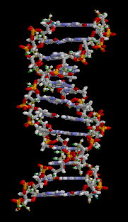
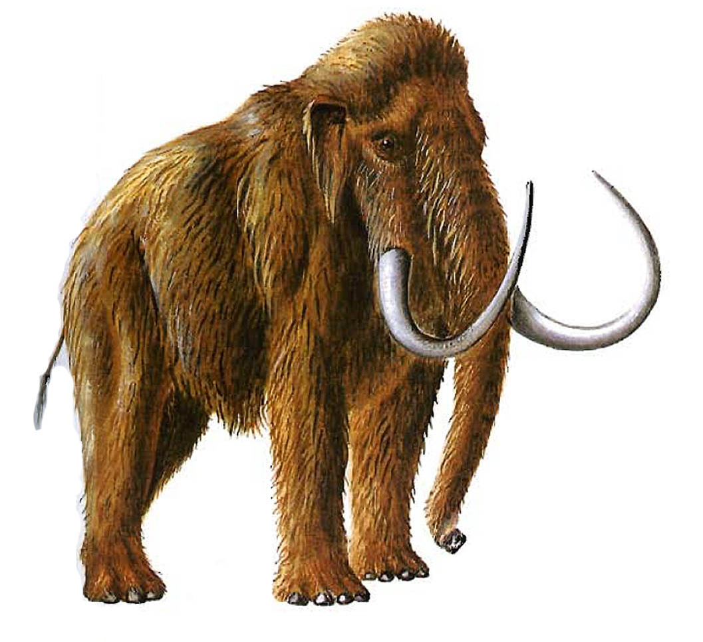
DNA Computing
What do we know about DNA?

Slide 7
DNA Computing
Is this true or is it Bull***t?
Science Fiction?
http://physicsworld.com/cws/article/news/2013/jan/23/digital-files-stored-and-retrieved-using-dna-memory
Notes:
Put on the board…

Slide 8
DNA Computing
How can RLE compression relate to DNA data storage?
(just another example of coding but using sequences of four bases - guanine (G), adenine (A), thymine (T), or cytosine (C).)
Notes:
Cross fertilisation of topics!

Slide 9
DNA Computing
https:/student.societyforscience.org/article/switch-living-computer
Answer these questions
What is a transistor?
What material have scientists used to build a transistor?
What have scientists called this new type of transistor?
What possible application of this emerging technology does Jerome Bonnet give in the article?
Where might DNA-based computers be able to work (unlike conventional computers)?
Notes:
Cross fertilisation of topics!

Slide 10
DNA Computing – really?
Biological switches (or transcriptors) could be used to turn germs in the body into disease hunters and to give out a signal if disease is detected
Programming molecules to probe their environments, process signals, make decisions and take actions.
Storage of lifelong keepsakes, such as wedding videos, public records.
Notes:
Cross fertilisation of topics!

Slide 11
DNA Computing – really?
Advantages | Disadvantages
Could work deep inside the human body – possible medical applications | Slower than conventional computing
DNA is a robust way of storing information | Still more expensive than conventional computing
DNA does not need power – storage and shipping is straightforward
There is a ready supply of DNA – so the DNA itself is a cheap resource
No toxic materials used (unlike conventional microprocessors)
Notes:
Cross fertilisation of topics!

Slide 12
Report title: When tech sounds like science fiction
Nano-technology
AI
Computational models, sequential, parallel, multi agent
DNA

Slide 13
Nano-technology
Nanotechnology
What is it?
What can it be used for generally?
How can it be used in the field of computing?

Slide 14
Artificial Intelligence
What is it?
Why is it so difficult to get right – what are the challenges?
What are the most common moral and ethical issues that AI raises?

