Slide 1
How can you program a computer to think like a person?
Why would you want it to?
Notes:
Arent we really all a little bit crap?

Slide 2
3 types of computational model
Three to learn – remember?

Slide 3
Lesson Outcomes
6.1.1 Be aware of current and emerging trends in computing technology [quantum computing, DNA computing, artificial intelligence (AI), nano technology]
All students will be able to define a broad meaning for the term AI
All students will be able to analyse an ethical issues to do with AI
Most students will be able to

Slide 4
AI
What is it?
http://www.csfieldguide.org.nz/ArtificialIntelligence.html
Notes:
Game / simulation playing – deep blue chess playing
Expert systems – making real life decisions (diagnose diesease based on symptoms)
Natural language – google translate
Neural networks – trying to reproduce connections and processes in the animal brain
Robotics – sensor – kernel - actuator

Slide 5
AI
What is it?
http://www.csfieldguide.org.nz/ArtificialIntelligence.html
Would you actually describe it as intelligent?
How might you go about programming something like that?
Come up with some rules that could guide
1. How should it react to certain words…

Slide 6
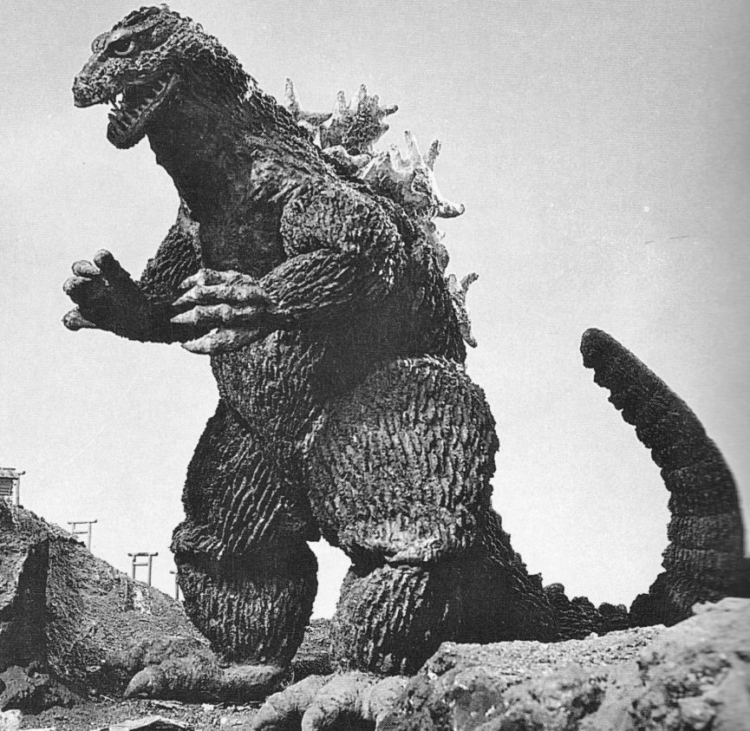
AI and Science Fiction - ethics
Science Fiction often parallels or mirrors our fears of technology and the future…
Godzilla was born from the experience and fear of the atomic bomb on Japan…

Slide 7
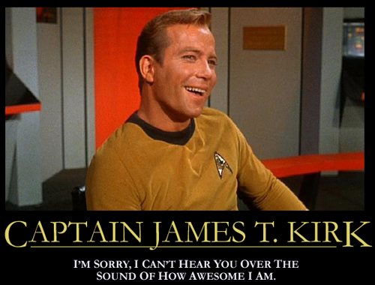
AI and Science Fiction - ethics
Science Fiction often parallels or mirrors our fears of technology and the future…
Watch star trek from the beginning and they deal with every ethical / political / racial / social topic or issue you can think of…

Slide 8
AI and Science Fiction - ethics
Science Fiction often parallels or mirrors our fears of technology and the future…
And for that matter – so has Dr WHO

Slide 9
AI and Science Fiction - ethics
Science Fiction often parallels or mirrors our fears of technology and the future…
Pushing it a bit…Star Wars is an anti war – vietnam war protest?

Slide 10
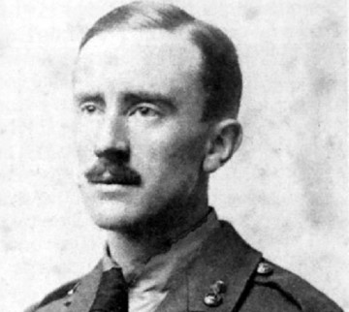
AI and Science Fiction - ethics
Science Fiction often parallels or mirrors our fears of technology and the future…
Lord of the Rings reflects Tolkiens time in the trenches of WW1

Slide 11
AI and Science Fiction - ethics
Science Fiction often parallels or mirrors our fears of technology and the future…
The first zombie films were satires on popular culture / capitalism / commercialism
Now you could argue that it’s a satire for our fear of germs and contamination.

Slide 12
AI and Science Fiction - ethics
AI plays a part in lots of science fiction: Go deeper – what is the deeper ethical issue the film is getting at..
Some examples:
The Matrix
Robocop (new or old one)
2001: A space odyssey
AI
I robot
Terminator
Short circuit
Battlestar Galactica
Eagle Eye
Transformers (just joking)
The Borg – Star Trek First Contact (in fact most star trek)
War games
Think of any others?
Notes:
Computers overpowering humans and outgrowing them – self sufficient (CONTROL)
The boundaries between man and robot blurring – when does a person stop being a person?
When a program becomes corrupt and malfunctions
What are the responsibilities of creating a something with human feelings – would we feel the same about them?
When should machines be given rights – when do they stop being robots (robot deriving from an exploited worker / slave) – When do WE become useless?
What happens when they become self aware
What does it mean to be ‘alive’
Not sure
Personal privacy -
Why are they cars?
The fear of being taken over by machines – losing our identity and becoming a slave
When does a simulation become too authentic?

Slide 13
Homework

