Slide 1
3.1.3 Program Flow control_1
Understand the need for structure
Breaking things down

Slide 2
Start - Keyword challenge – so far...
Constant
Assignment
Data
System
Information
Array / list
Variable
Algorithm
Boolean
Data structure
Pseudocode
Object Orientated Programming
Integer
Binary
Identifier
Real / Float
Notes:
This could be viewed as a collection of interacting objects, as opposed to a program that is seen as a sequence of tasks to perform.
The process of setting a value to a variable
A set of facts of figures that have no meaning
A data type that only stores two values
Data that has been processed to give the user context and meaning
A step by step approach to solving a problem
A type of general code used to describe programming and the algorithms
A data structure that used to store multiple values in a single variable
A data type that is used for only positive or ne

Slide 3
Lesson outcomes
Understand why we should design a programming solution
Know the difference between a structure chart and a flow chart
Be able to feedback why its an advantage to have structured programming.
Be able to feedback the 3 fundamental building blocks in programming structures

Slide 4
Quick one - Why design?
Give 5 reasons why you would take time to design and plan a program solution before sitting and coding it...
Notes:
Program design and the actual programming

Slide 5
Quick one - Why design?
Give 5 reasons why you would take time to design and plan a program solution before sitting and coding it...
The name given to this
planning is called:
Control structured programming
Notes:
Program design and the actual programming

Slide 6
Program Control Structure
Brief introduction to the fundamental building blocks in structured programming.
Sequence -
Selection -
Iteration (looping, repetition) -
Notes:
Sequence – a set of instructions or actions is ordered, meaning that each action follows the previous action
Selection – are usually expressed as ‘decisions’ keywords such as if, then, else
Iteration – Executed in a loop until the program reaches a certain state or the operations have been applied. Keywords such as while, repeat, for, do...

Slide 7
Why break programming down?(Revision from before half term)
Why is it an advantage to have structured programs?
Scenario:
You have been asked to create a coded solution that works out employees wages each month.
We have already said that we wouldn’t just dive in – we would design it first.
Notes:
Could do a possible memory test...

Slide 8
Why break programming down?(Revision from before half term)
Scenario:
You have been asked to create a coded solution that works out employees wages each month.
Lets try and break down the task into smaller tasks. (MODULES)
Notes:
Each person needs to have a particular task:
Pension
Tax
Before tax
After tax
Printing payslip
Bonuses

Slide 9
Why break programming down?(Revision from before half term)
What’s the advantage? Answer these:
Common sense:
What advantage is there to splitting a coded solution up into smaller defined modules?
What advantage is there to a group of programmers working on smaller defined modules?
What advantage is there to working with smaller modules if the program needs updating or replacing?
Notes:
Could do a possible memory test...

Slide 10
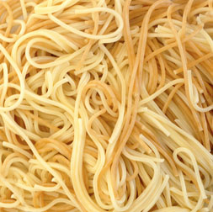
Quick break – another reason to use structured program control
Spaghetti code!
Notes:
Anyone hazard a guess

Slide 11
Quick break – another reason to use structured program control
10 i = 0
20 i = i + 1
30 PRINT i; " squared = "; i * i
40 IF i >= 10 THEN GOTO 60
50 GOTO 20
60 PRINT "Program Completed."
70 END
Spaghetti
code!
Using ‘For’ and ‘while’ loops
Action 1
Action 2
Action 3
Action 4
Notes:
Using goto statements = this can lead to code that is disorganised, unstructured code which is very difficult to follow.

Slide 12
Breaking down and solving problems in a graphical way...
Structure chart
“A breakdown of the different parts of a system”

Slide 13
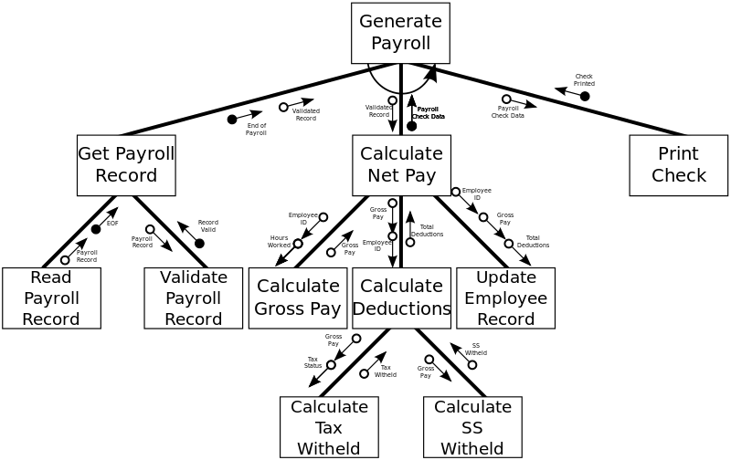

Slide 14
Breaking down and solving problems in a graphical way...
For smaller – coding projects:
Top down structured flowchart methodology
“A breakdown of the different parts of an algorithm or process”

Slide 15
Pay > 40K
false
true
Pay income tax at 40%
Pay income tax at 10%

Slide 16
Breaking down and solving problems in a graphical way...
Notes:
Start – It always has on output, usually has a description of the process
End – It always has one input,
Process – An operation that is carried out on an element of data (this could be broken down further)
Decision – Makes a boolean choice. Should be a question that clearly has two possible answers. One input – two outputs

Slide 17
Keywords/phrases used this lesson
Sequence
Iteration
Selection
Program flow
Flow chart
Structure chart
Modules
Algorithm
Spaghetti code

Slide 18
Snakes and ladders – complete this flowchart
Start
yes
Slide down snake
no
yes
no
End
Notes:
Complete this simple flow chart

