Slide 1
Starter
Success criteria
There you have the syllabus for this particular part of the course.

Slide 2
Computer Science 3.1.1
Constants_variables and data types 1

Slide 3
Success criteria for the lesson
Be able to Explain what a system is
Explain the difference between data, information and knowledge
List the main data types
Compare different types and recommend which is used when

Slide 4
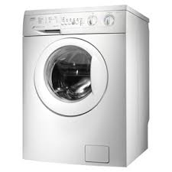
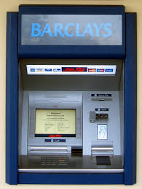
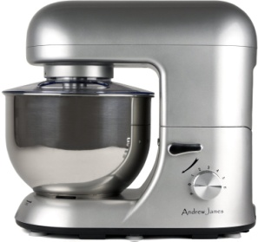
A system: Explain what’s going on here:
?
?
?
?
?
?
Notes:
A system...input > process > output

Slide 5
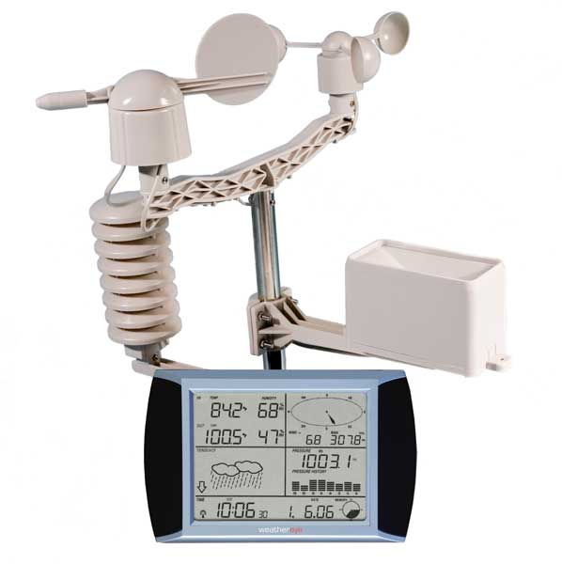
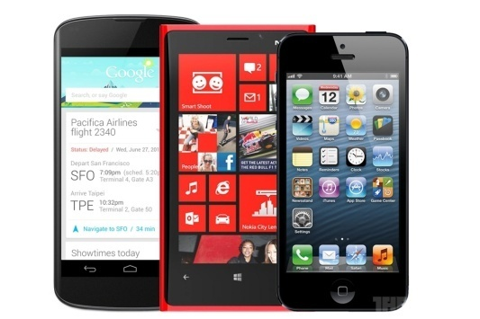
A system: Explain what’s going on here:
?
?
?
?
Notes:
A system...input > process > output

Slide 6
So what makes up a system?
You tell me...give me a definition.
Notes:
Think of a situation and complete a diagram demonstrating how it is a system.

Slide 7
Progress check

Slide 8
What’s this?
80
25
32
52
42
161
Notes:
My door numbers for my previous addresses

Slide 9
What’s this?
18,600,000
Notes:
Lines of code needed to fly and maintain the US Joint Strike Fighter

Slide 10
What’s this?
Atkins, Alan | Yes
Barnard, Jack | Yes
Cooper, Morgan | Yes
Cornell, Daniel | Yes
Dempsey, Aidan | Yes
Hawkes, John | Yes
Hoddinott, Charles | Yes
Johnson, Connor | Yes
Jones, Rhys | Yes
Morse, Samuel | Yes
Okyere, Martinson | Yes
Oram, Taylor | Yes
Rehal, Baldip | Yes
Stepton, Luke | Yes
Watkinson, Andrew | Yes
Wheal, Jay | Yes
Wood, Cody | Yes
Notes:
People I could beat in a fight

Slide 11
Data
Give it meaning
Could be: Facts, figures, numbers, characters, symbols, images
Information
Putting Data into a context
Knowledge
Share
Information about things, facts and opinions that has been shared

Slide 12
So what’s that got to do with a system?
Input
Process
Output
Data
Meaning
Knowledge

Slide 13
Progress check

Slide 14
Input
Process
Output
Data
Meaning
Knowledge
Process this information by sorting it for me....
Notes:
We give computers data to process so we can find meaning and create knowledge
Get into groups and sort this data...

Slide 15
Why do we need different data types? Which below do you think are true?
To make saving onto disk easier?
So we can group data types together?
Processing is simpler?
So the system doesn’t crash?
SO it can be sent through a logic gate?
Reduced chance of errors being made when handling data?
To hold more data?

Slide 16
Couple of questions...
Which of the following data would you store as an integer and which as a string?
Steve
15
007
B901LK
2012
10.2
Marks
Which is the odd one out and what would you store it as?

Slide 17
Couple of questions...
Which of the following are integers?
6
-7
2.6
10
4.5
17
17.0

Slide 18
Couple of questions...
Which of the following are just data and which are information?
65
NN126DD
22 Harrow Lane
Is a cooking recipe information or data?

