Slide 1
Computer Science 4
On and OFF

Slide 2
Homework
What have we created.

Slide 3
Homework – post mortem
Look at this:
Stomach full?
Feed
Yes
No
Sleep

Slide 4
Homework – post mortem
Look at this: Its not complete?
Sleep
Stomach below 20% full
Yes
Yes
Wake
Feed
No
Stomach comfortable?
No
Yes
Vomit
Better?
Sleep

Slide 5
Homework – post mortem
Take a flowchart...
Does the algorithm flow?
Are there any possibilities that it could crash or remain in a loop?

Slide 6
Quick question
Which is the one you are most likely to program with?
High level language
Machine code

Slide 7
Learning Objectives
All will be able to explain the significance of ON and OFF and explain what binary is
Most will be able to convert denary to binary numbers and vice versa
Some will be able to convert and understand hexadecimal numbers.

Slide 8
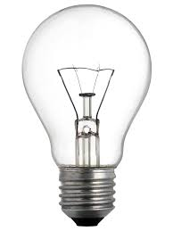
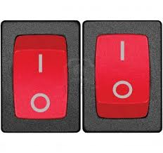
Simple concept Got it?
0
1

Slide 9
In the old days – computers were built slightly different
Switches control circuits that control the signals around the machine.
Switching on and off, on and off over and over again millions of times.
Current
signal
off
Current
signal
off
Current
signal
on
Current
signal
Current
signal
off

Slide 10
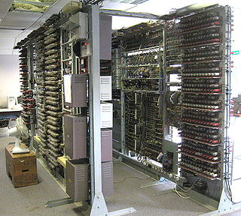
http://www.youtube.com/watch?v=knXWMjIA59c

Slide 11
Binary
Imagine 8 bulbs / switches with 2 states
On and off
1 and 0
Notes:
255 is the biggest number

Slide 12
Binary
8 bits = 1 byte
bit
bit
bit
bit
bit
bit
bit
bit
1 byte
Notes:
255 is the biggest number

Slide 13
Binary
Lets give each bulb a value
128 | 64 | 32 | 16 | 8 | 4 | 2 | 1
Notes:
255 is the biggest number

Slide 14
Binary
What does this value represent?
128 | 64 | 32 | 16 | 8 | 4 | 2 | 1
Notes:
33

Slide 15
Binary
What does this value represent?
128 | 64 | 32 | 16 | 8 | 4 | 2 | 1
Notes:
101

Slide 16
Binary
Take away the bulbs and represent with
1 and 0s
What does this value represent?
128 | 64 | 32 | 16 | 8 | 4 | 2 | 1
0 | 0 | 0 | 1 | 1 | 0 | 0 | 0
Notes:
24

Slide 17
Key words
Denary (decimal numerical system)
Binary (representing values using 1 and 0s) – used by all computers and digital devices.

Slide 18
Binary to denary
Convert these:
A
0 | 1 | 1 | 0 | 0 | 0 | 1 | 0
B
1 | 0 | 0 | 0 | 1 | 0 | 0 | 1
C
0 | 0 | 1 | 1 | 1 | 0 | 0 | 0
Notes:
98
137
56

Slide 19
Denary to Binary
Convert these:
A
180
B
42
C
201
Notes:
Do we need help?
180-128-64-32-16-8-4-2-1

Slide 20
It can also represent text
http://www.roubaixinteractive.com/PlayGround/Binary_Conversion/Binary_to_Text.asp

Slide 21
Other - Hexadecimal
Base 2
Base 10
Now = Base 16 (because we can represent a byte with 2 letters)
Dec | 0 | 1 | 2 | 3 | 4 | 5 | 6 | 7 | 8 | 9 | 10 | 11 | 12 | 13 | 14 | 15
Hex | 0 | 1 | 2 | 3 | 4 | 5 | 6 | 7 | 8 | 9 | A | B | C | D | E | F

Slide 22
From Base 16 to Base 10
Dec | 0 | 1 | 2 | 3 | 4 | 5 | 6 | 7 | 8 | 9 | 10 | 11 | 12 | 13 | 14 | 15
Hex | 0 | 1 | 2 | 3 | 4 | 5 | 6 | 7 | 8 | 9 | A | B | C | D | E | F
Convert 3C from base 16 to base 10
16 | 1
3 | C
3x16=48 | 12x1=12 | 48+12 = 60 in base 10

Slide 23
From Base 16 to Base 10
Dec | 0 | 1 | 2 | 3 | 4 | 5 | 6 | 7 | 8 | 9 | 10 | 11 | 12 | 13 | 14 | 15
Hex | 0 | 1 | 2 | 3 | 4 | 5 | 6 | 7 | 8 | 9 | A | B | C | D | E | F
Convert 5F from base 16 to base 10
16 | 1

Slide 24
From base 10 to Base 16
Dec | 0 | 1 | 2 | 3 | 4 | 5 | 6 | 7 | 8 | 9 | 10 | 11 | 12 | 13 | 14 | 15
Hex | 0 | 1 | 2 | 3 | 4 | 5 | 6 | 7 | 8 | 9 | A | B | C | D | E | F
Convert 45 from base 10 to base 16
16 | 1
45/16=
Remainder=

Slide 25
From base 10 to Base 16
Dec | 0 | 1 | 2 | 3 | 4 | 5 | 6 | 7 | 8 | 9 | 10 | 11 | 12 | 13 | 14 | 15
Hex | 0 | 1 | 2 | 3 | 4 | 5 | 6 | 7 | 8 | 9 | A | B | C | D | E | F
Convert 235 from base 10 to base 16
16 | 1
235/16=
Remainder=

Slide 26
Extension
Dec | 0 | 1 | 2 | 3 | 4 | 5 | 6 | 7 | 8 | 9 | 10 | 11 | 12 | 13 | 14 | 15
Hex | 0 | 1 | 2 | 3 | 4 | 5 | 6 | 7 | 8 | 9 | A | B | C | D | E | F
Convert 3B to binary
16 | 1

Slide 27
Extension even further

